Slide 1
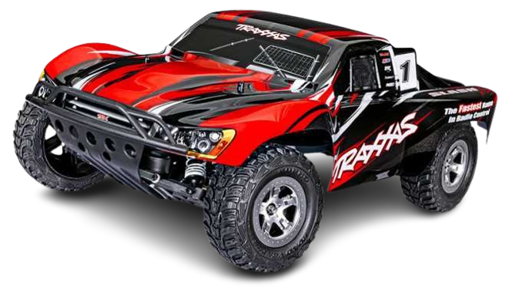
Traxxas Slash 4x4 Vxl
ME49601 TOOLS/METHODS FOR ITERATIVE PRODUCT DESIGN & ANALYSES
Team Trophy Truck
Jonathan Jackson, Connor Day, Sidh Gurnani, William Snyder
School of Mechanical Engineering, Purdue University

Slide 2
Outline
Team Organization and Collaboration
File Structures
Team organization
Roles and Responsibilities
CAD Overview
CAD structure
Wireframe and Shared Parameters
Surface and Solid Modeling
Mass Properties
Analysis
Component and Assembly FEA
Topology Optimization
CFD
Visualization

Slide 3
Team Organization and Communication

Slide 4
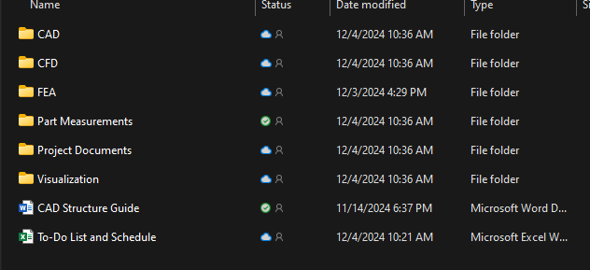
Team Organization and Communication
File Structures
OneDrive Shared folder with all files
Files transfer to other softwares:
FEA → STEP files
CFD → Parasolid Files

Slide 5
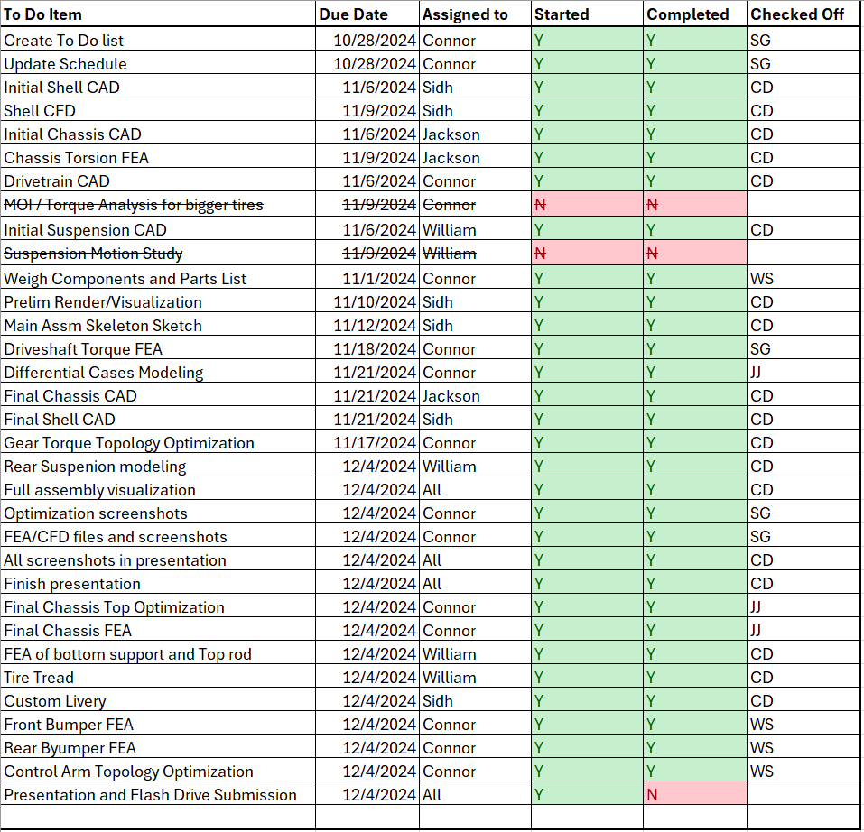
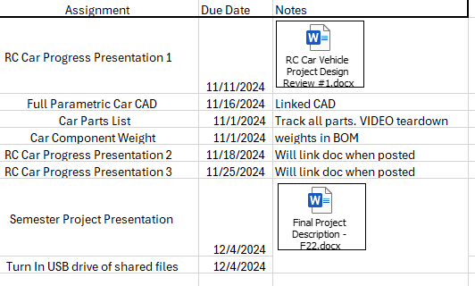
Team Organization and Communication
Team Organization
Item Checklist
Helped with accountability and progress tracking
Schedule to keep all deadlines and relevant information in one place
Text Group chat for easy communication
Parts List and BOM:
Helps keep track of parts and also ensures the team doesn’t overlook parts during CAD and Analysis
Not all hardware is included in BOM, but instructions on where to keep hardware are provided
Team Standards:
Standardization of units, naming conventions
Text Group chat with reminders

Slide 6
Team Organization and Communication
Roles and Responsibilities
Name | Responsibility
Jonathan Jackson | Chassis
Connor Day | Drivetrain/FEA & Topology
Sidh Gurnani | Primary Shell Surface/CFD
William Snyder | Front/Rear Suspension

Slide 7
CAD Overview

Slide 8
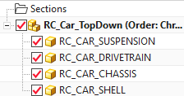
CAD Overview
CAD Structure
Top-Down Skeleton
Overall System Geometry
Subsystems
Shell
Expressions
Drivetrain
Chassis
Suspension

Slide 9
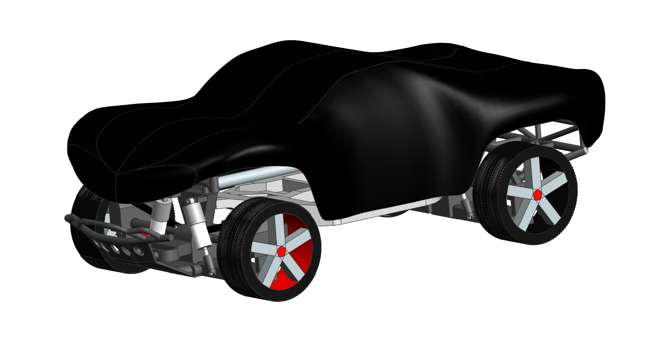
Overall CAD

Slide 10
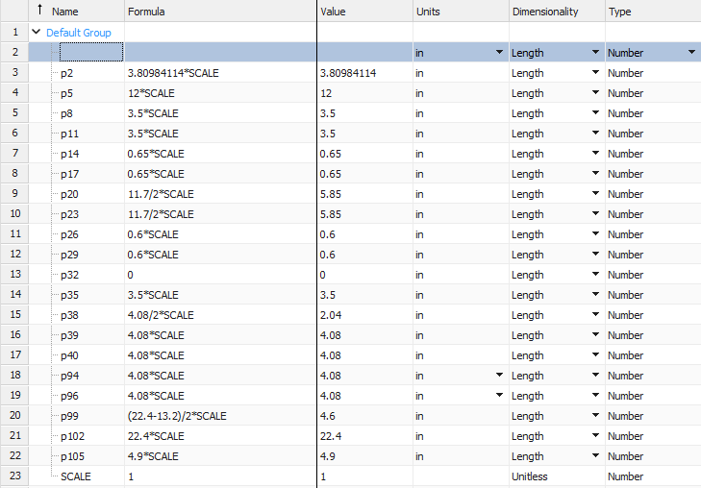
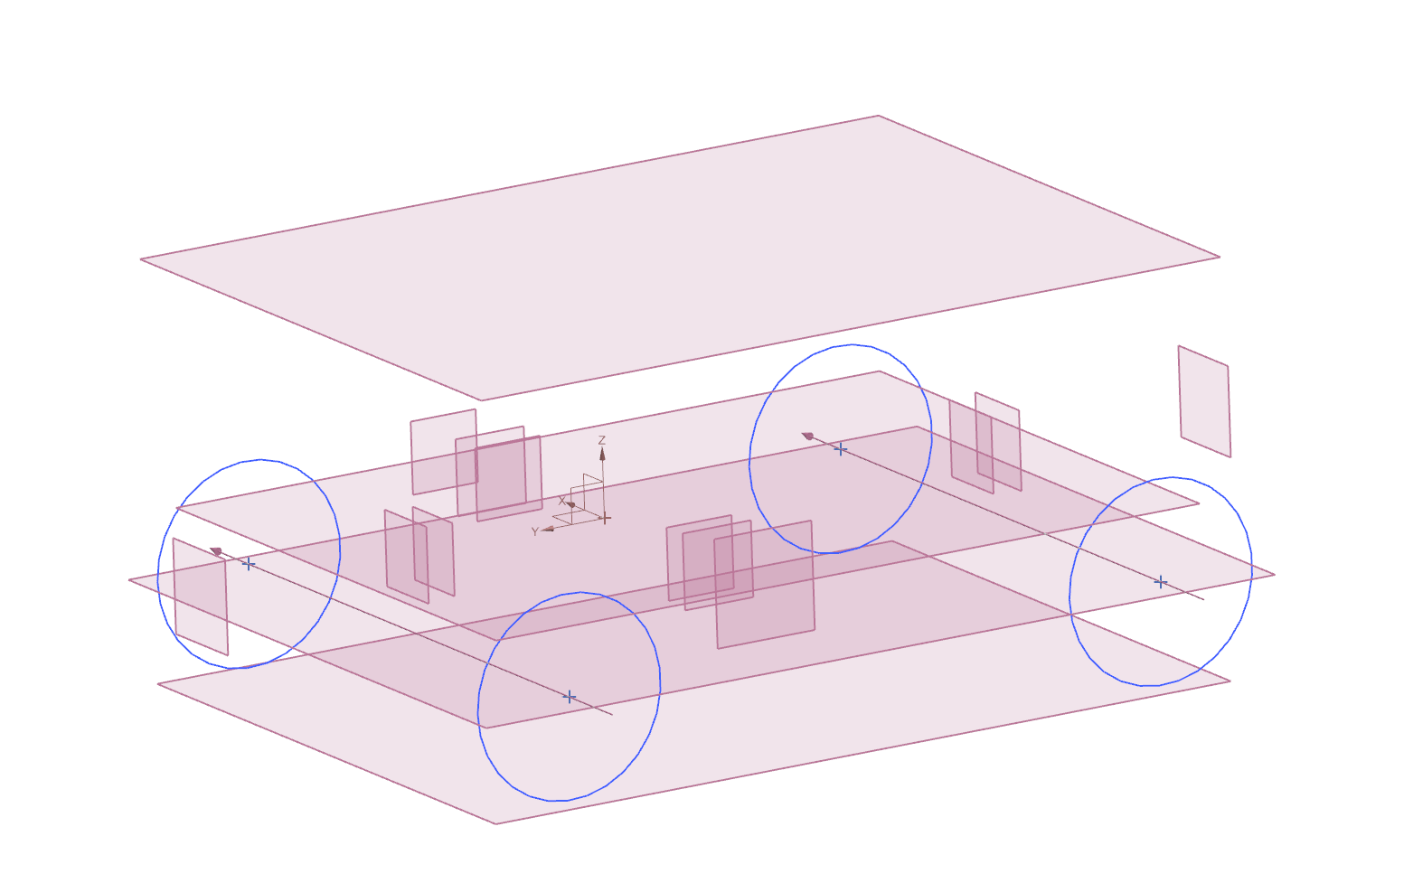
CAD Overview
Wireframe and Shared Parameters
Global Scale Factor
Accurate Datum Planes/Wireframe model for sub-assembly references
Relevant geometry from skeleton and wireframes wavelinked into parts and assemblies as needed
Linked parameters were also used to share dimensions

Slide 11
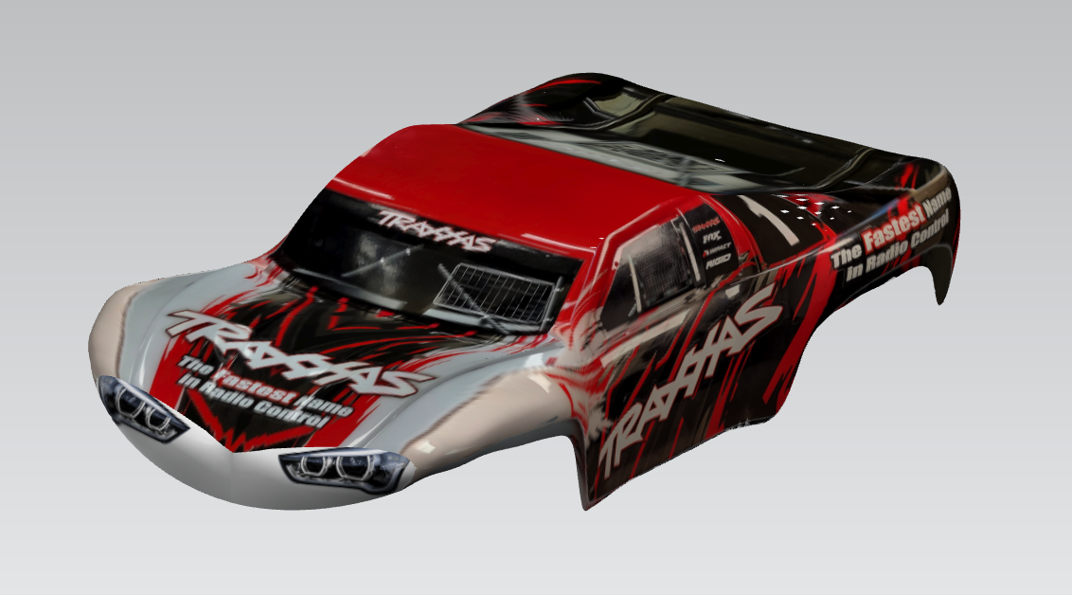
CAD Overview
Primary Surface Modeling

Slide 12
CAD Overview
Primary Surface Modeling
Slightly modified from Traxxas’s
Overall tighter packaging and reduction of sharp corners throughout surface
Creates smoother surface overall

Slide 13
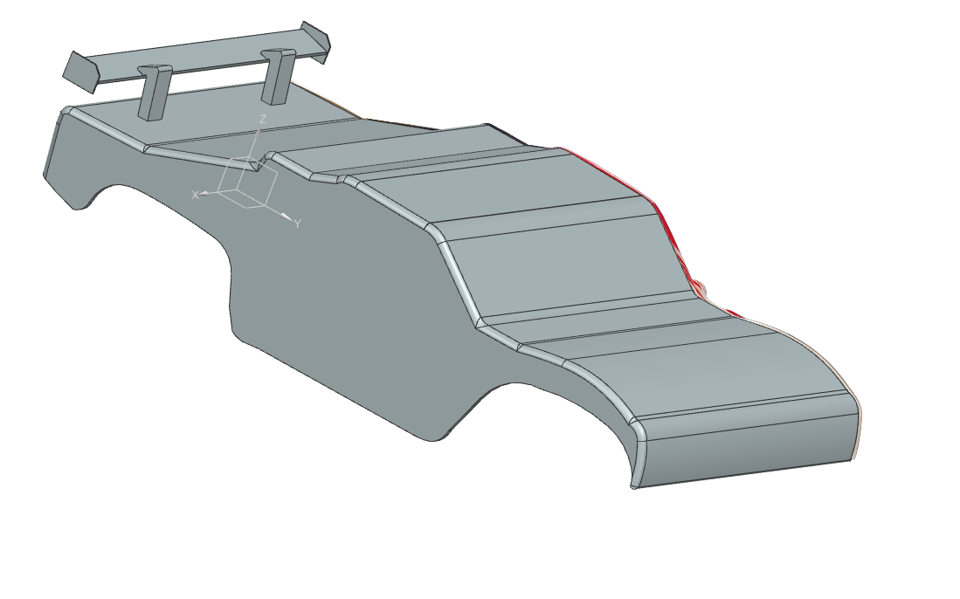
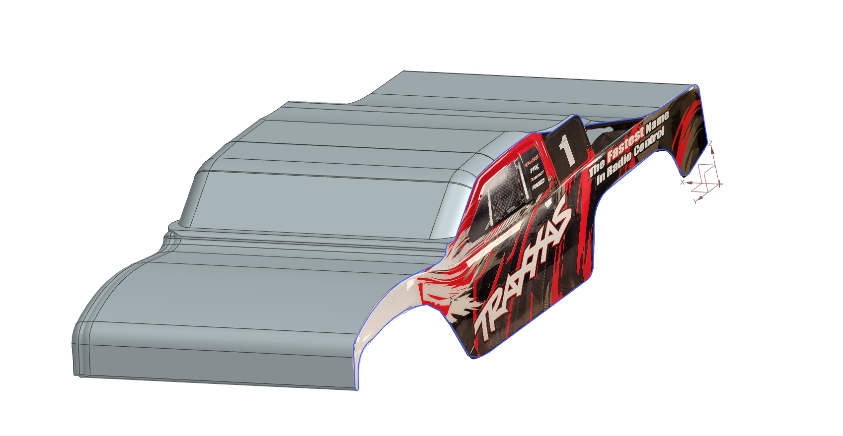
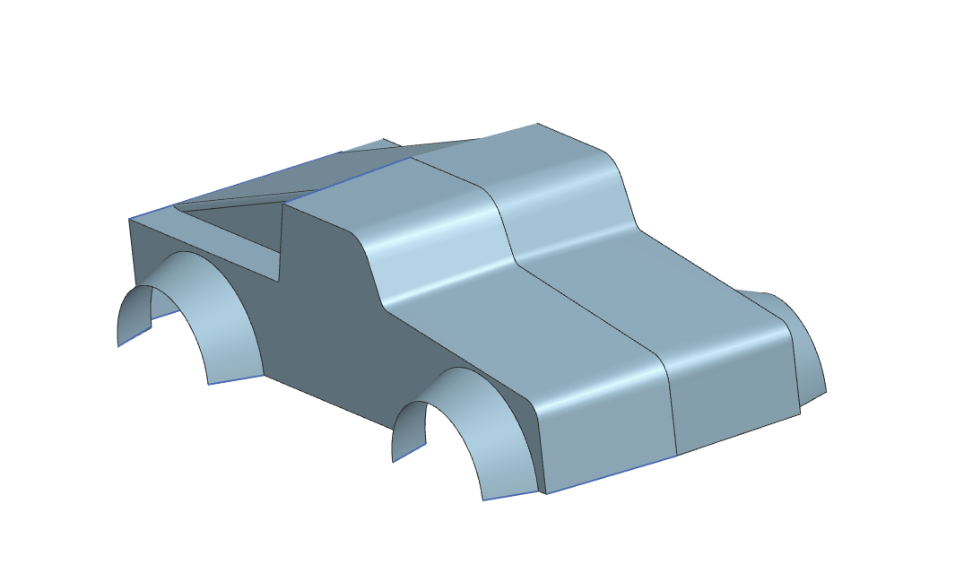
CAD Overview
Secondary Surface Modeling

Slide 14
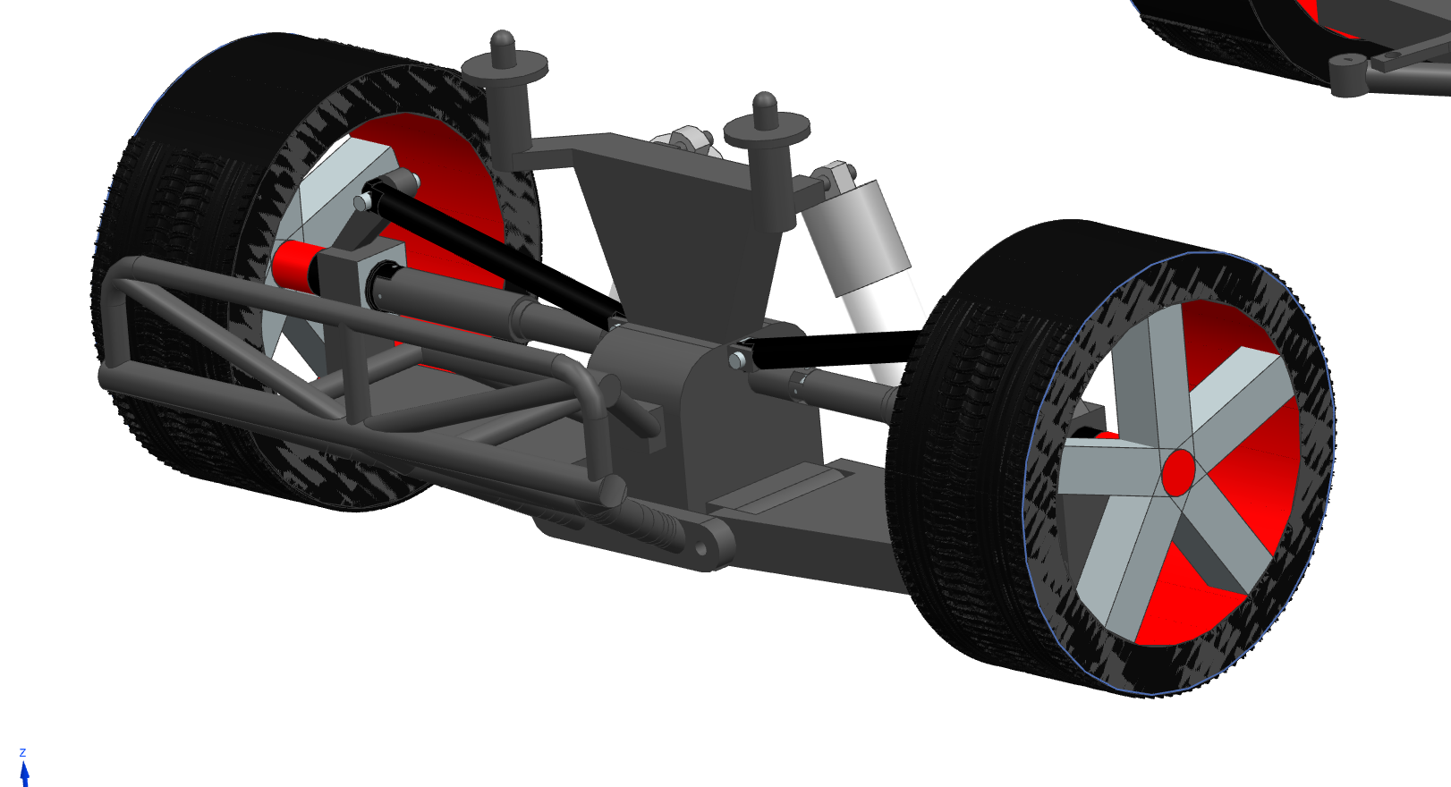
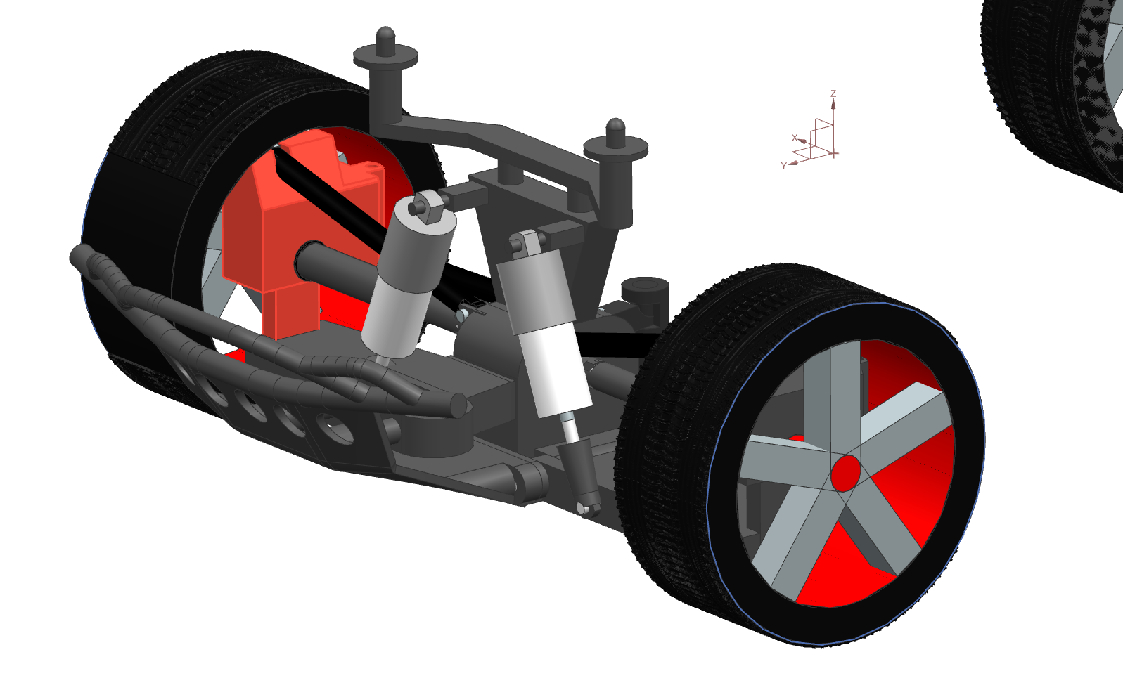
CAD Overview
Solid Modeling: Suspension Subassemblies
Select parts were modeled with Optimization in mind

Slide 15
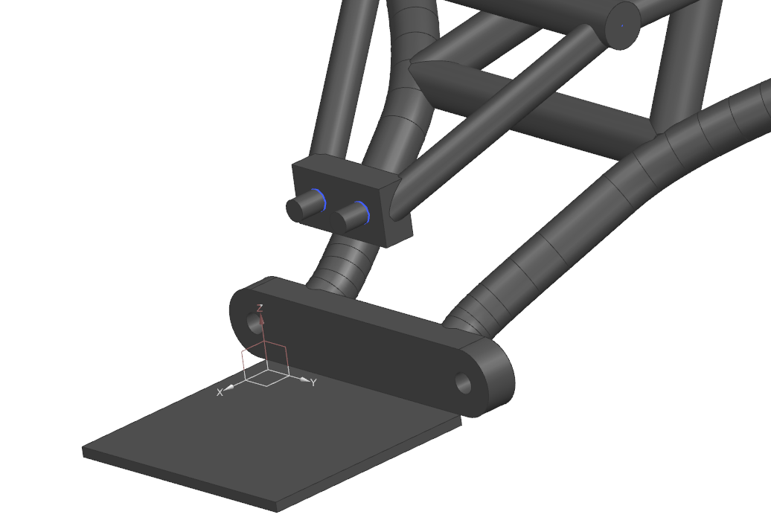
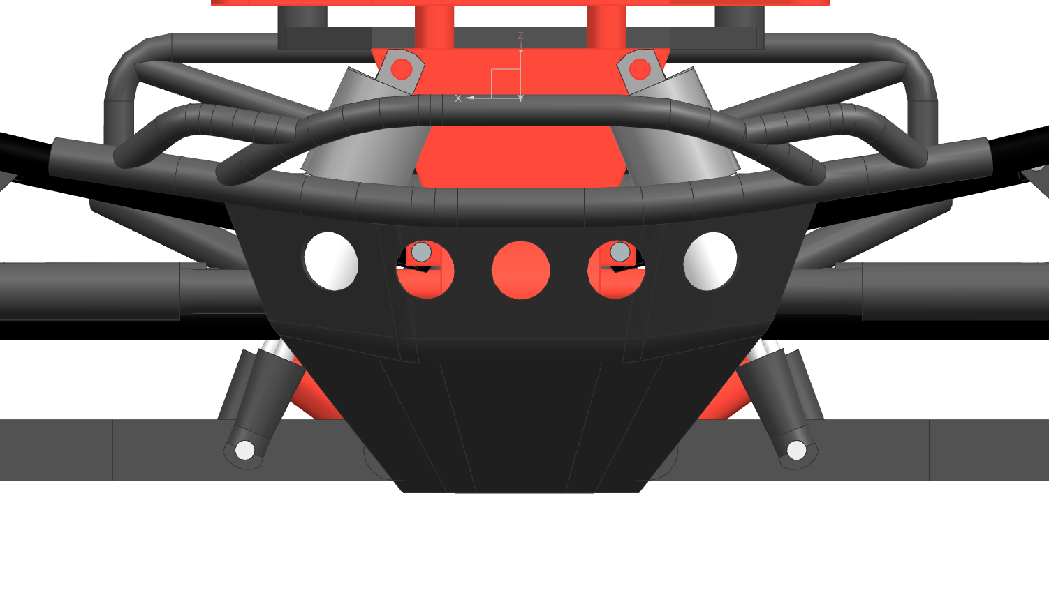
CAD Overview
Solid Modeling: Suspension Re-Engineering
Rear suspension had no upper supports
Rear suspension location change

Slide 16
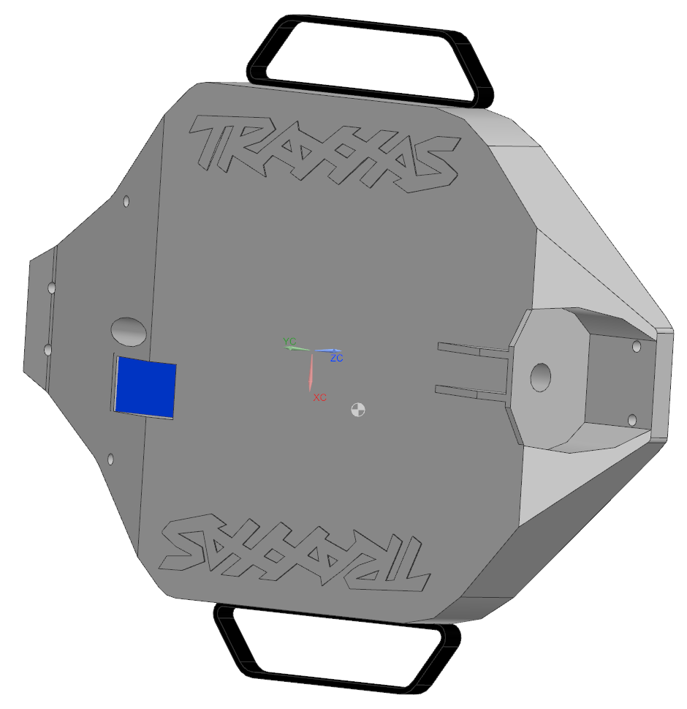
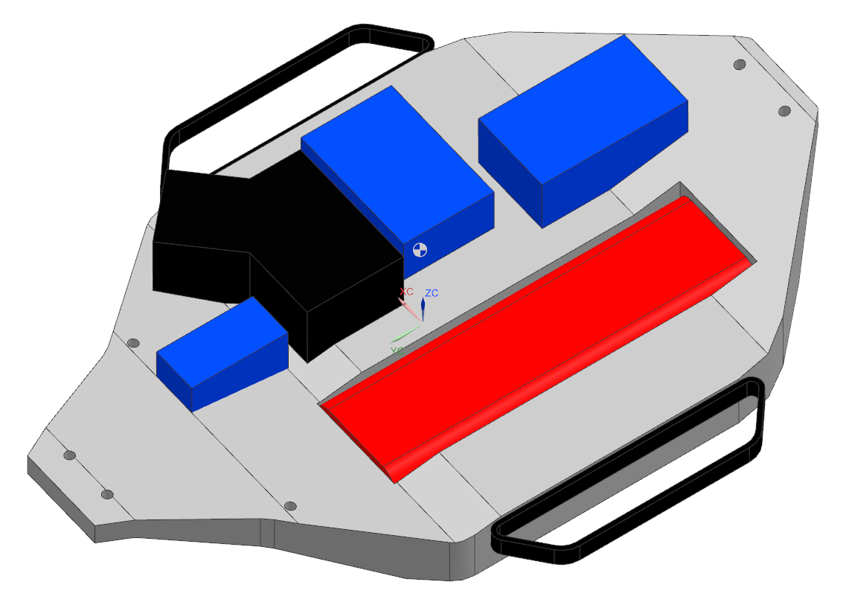
CAD Overview
Solid Modeling: Chassis
Modeled with optimization in mind
More time for finer details
Integrate with front & rear suspension

Slide 17
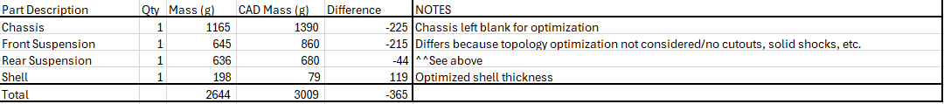
CAD Overview
Mass Properties
Mostly ABS Plastic (high impact in Ansys)
Shell is Polycarbonate
Yield Strength: 40 ksi
Differs in CAD because of lack of optimized parts and design improvements

Slide 18
Analysis and Optimization

Slide 19
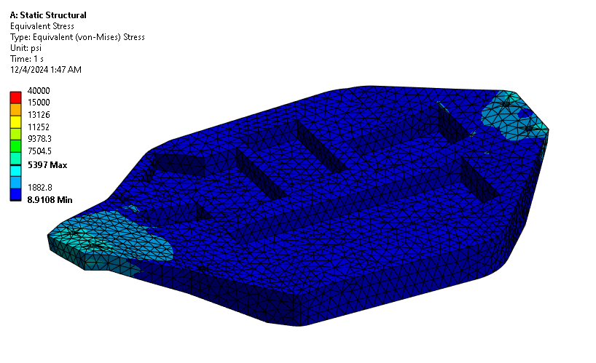
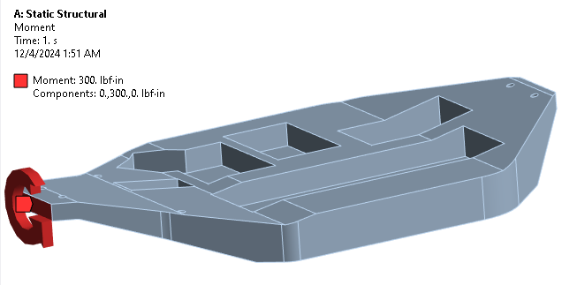
Analysis and Optimization
Chassis Torsion and Impact FEA
Fixed back plane
Cylindrical Supports at bolt holes
Tetrahedral Mesh size: .25”
Moment applied at front face
Torsional stiffness provides basis for future assembly FEA and validates rigid constraints. Low deflection shows this is strong enough to assume this.

Slide 20
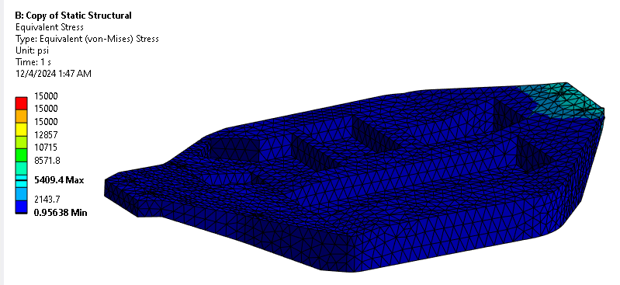
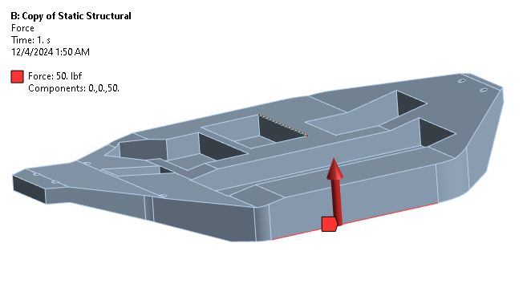
Analysis and Optimization
Chassis Side Impact FEA
Same setup as previous
50lbs on leftmost edge upward
Stress is high but not close to 2.0 FOS

Slide 21
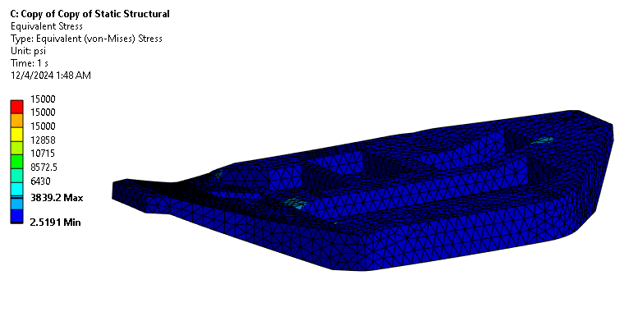
Analysis and Optimization
Chassis Front Impact FEA
Same Fixed Geometry
500lbf applied at front face
Low stress allows for much material removal

Slide 22
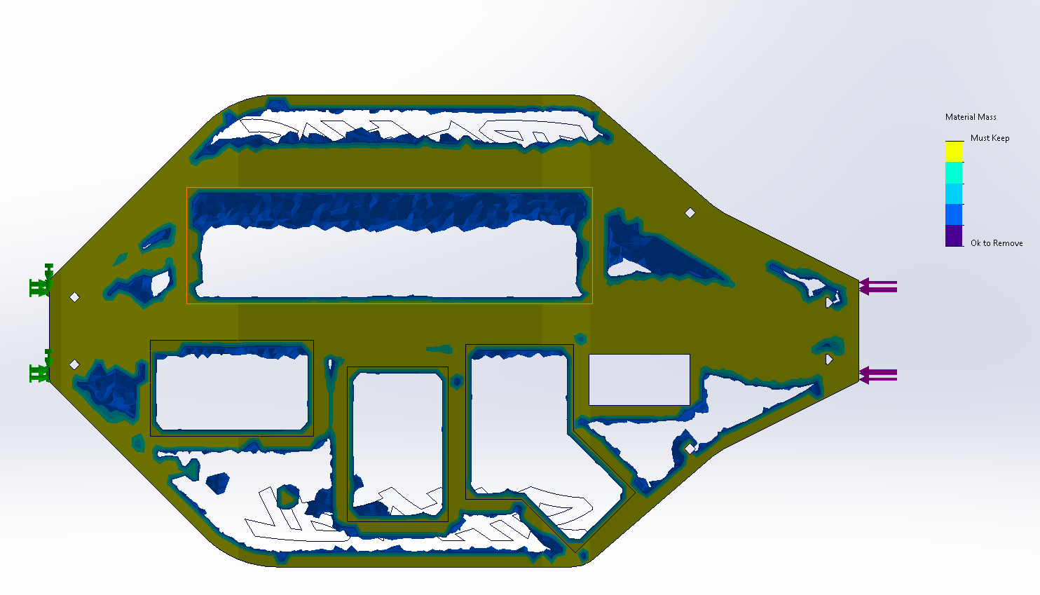
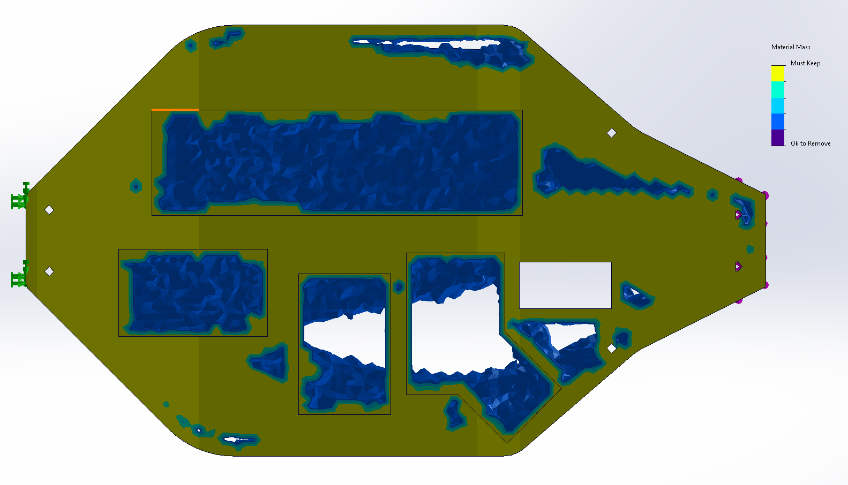
Analysis and Optimization
Chassis Topology Optimization
Kept outside geometry
Fixed back face
20% weight reduction and 1.3 stiffness factor
Force applied at front edge to simulate front impact, putting chassis in bending
Significant amount of material can be removed
Study 1
Study 2

Slide 23
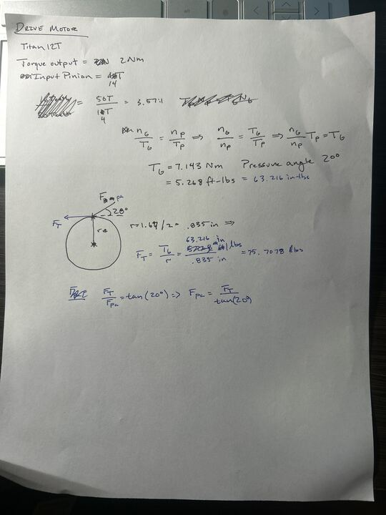
Analysis and Optimization
Drivetrain FEA Torque Calcs
Motor Data:
Titan 12T
Max Torque Output: 1.5-2Nm
Gear Ratio: 3.57:1
Pressure Angle: 20 deg.
Torque at Gear: 63.216 in-lbs
Equivalent Force Tangent = 75.708 lbs
Equivalent Force at Pressure angle: 208.005 lbs

Slide 24
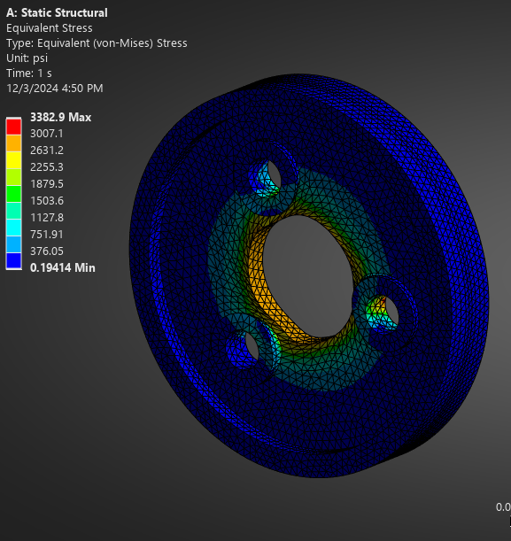
Analysis and Optimization
Drive Gear FEA
Tetrahedral Mesh (size .035 in)
ABS plastic (high impact)
Torque applied from calculation: 63.2 in-lbs at center cylinder
Fixed cylindrical supports at bolts and at edge
Material Yield: 36 ksi

Slide 25
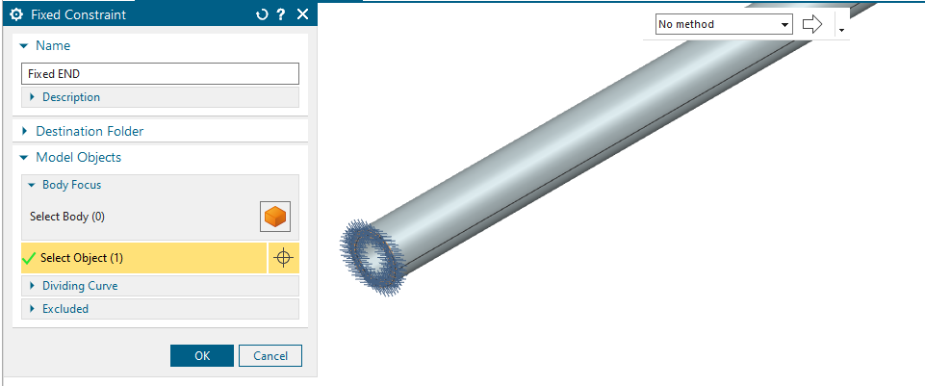
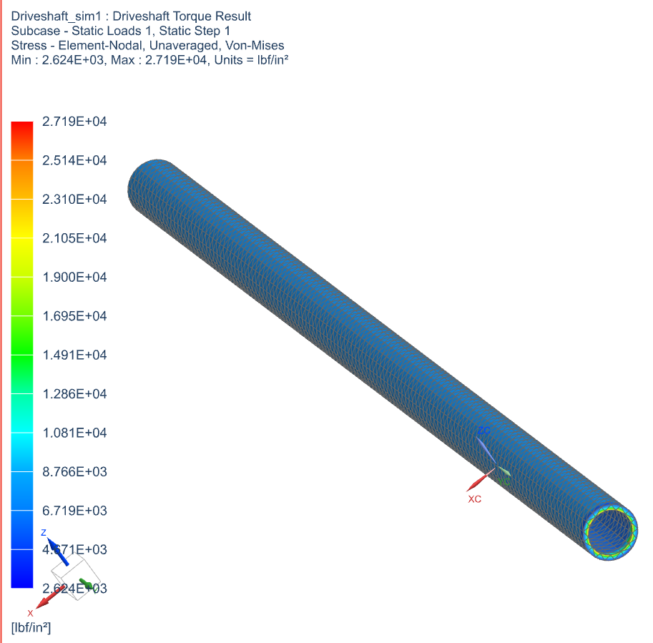
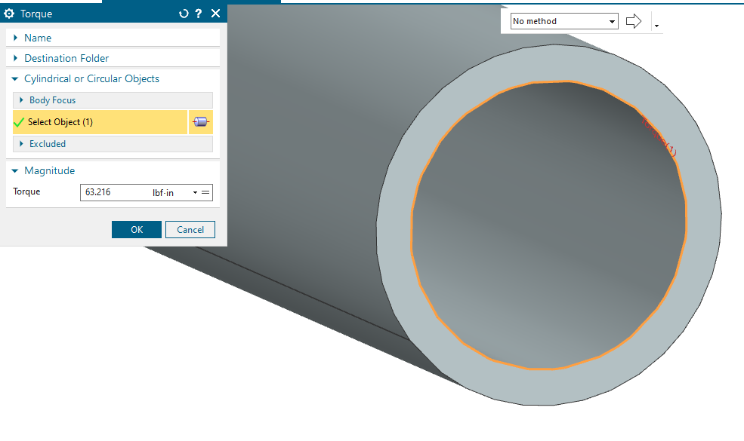
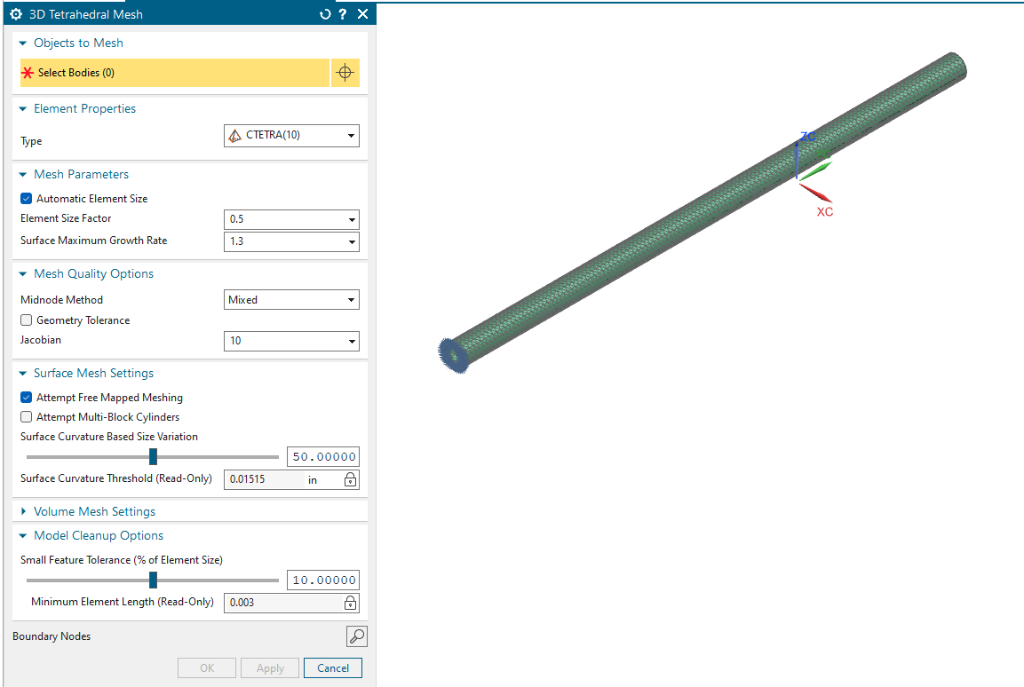
Analysis and Optimization
Driveshaft FEA
Applied Torque
Fixed Constraint
Result
3D Tet Mesh

Slide 26
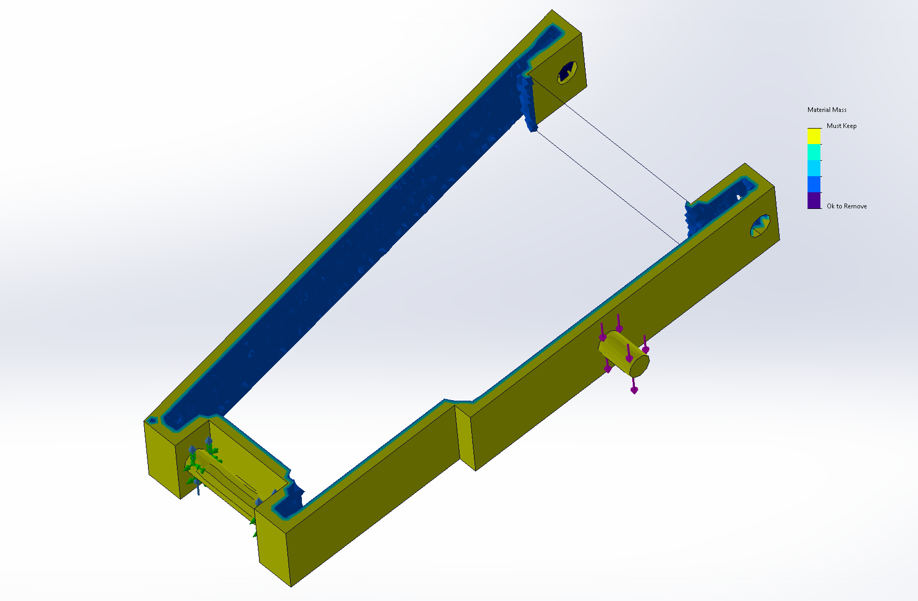
Analysis and Optimization
Bottom Support Topology Optimization
Cylindrical Supports at bolt holes and bearing
Keep Geometry outline
Forces applied at outer cylinder and shock mount point
20% weight reduction and 1.2 deflection factor
Would need to keep material in center for additional stiffness

Slide 27
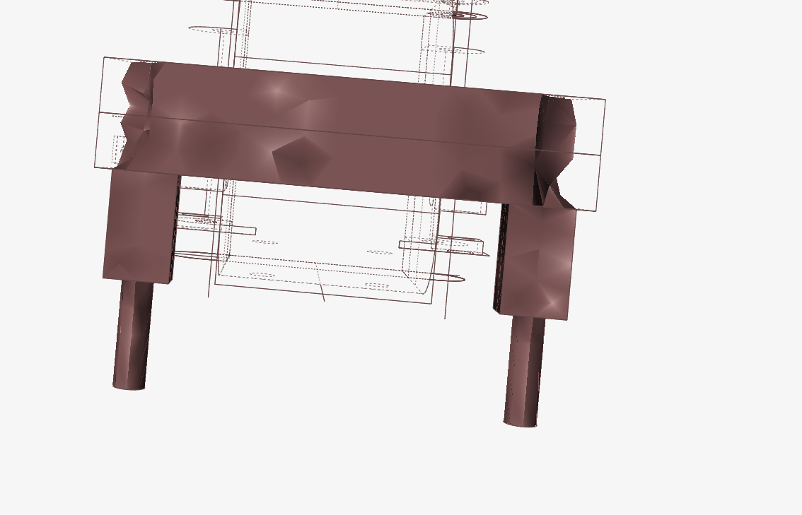
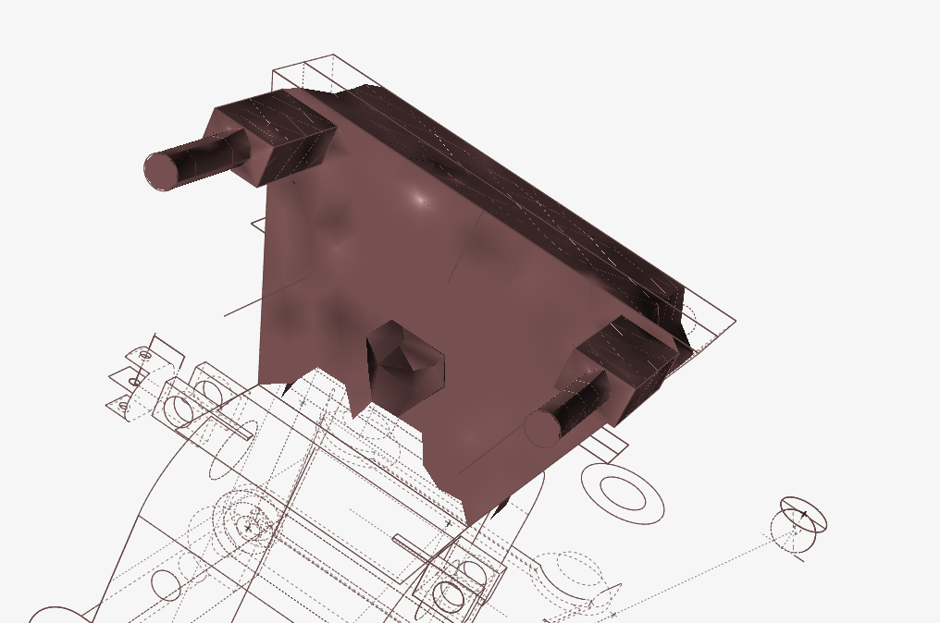
Analysis and Optimization
Suspension Center Piece Topology Optimization
Fixed geometry
100 lb applied at 30 degrees

Slide 28
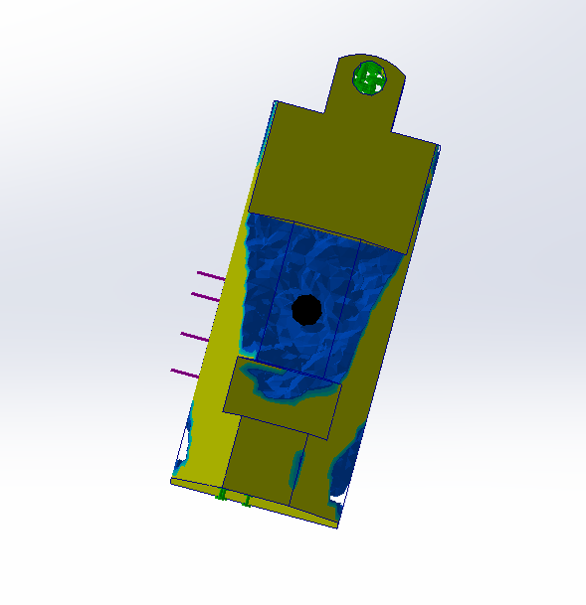
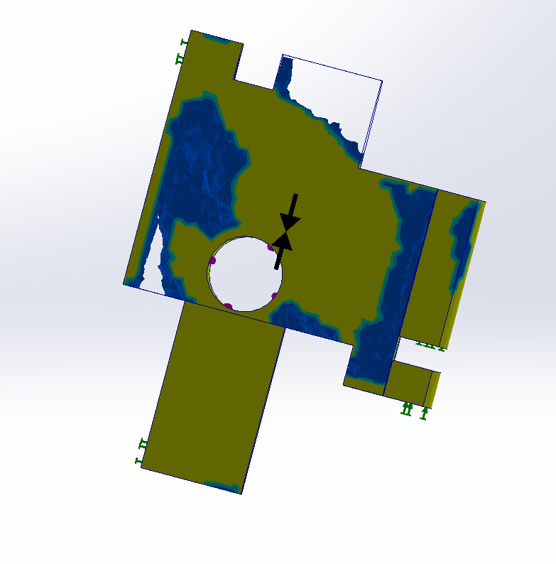
Analysis and Optimization
Wheel Attachment Topology Optimization
Manufacturing constraints on holes for bolts and wheel
Fixed geometry at outer boundaries
Force Applied at the Wheel Center Inboard
10% weight reduction and 1.1 deflection factor

Slide 29
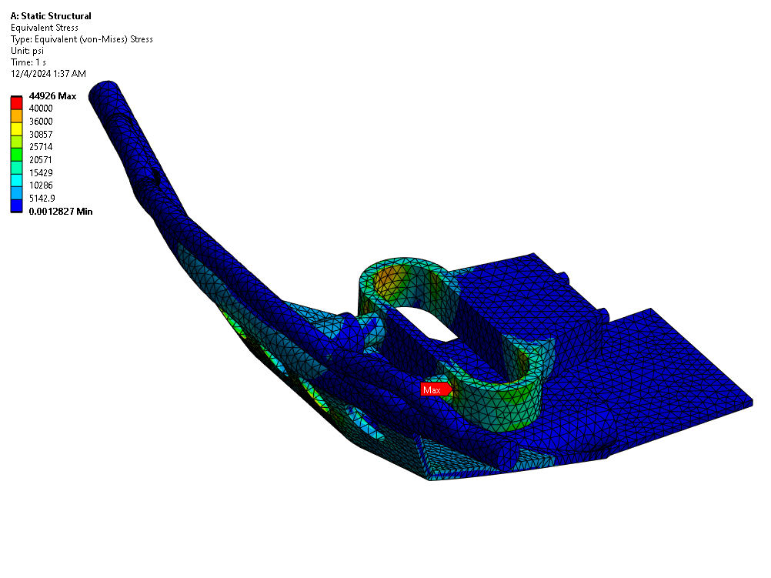
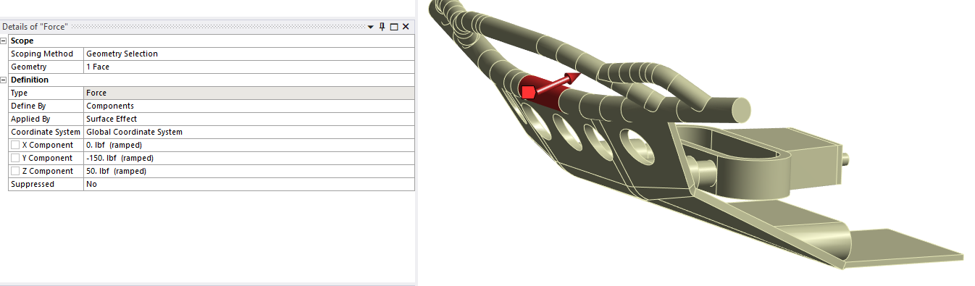
Analysis and Optimization
Front Bumper FEA
Cylindrical Supports at bolts and posts
Force applied as shown
Tetrahedral Mesh Size: .1”

Slide 30
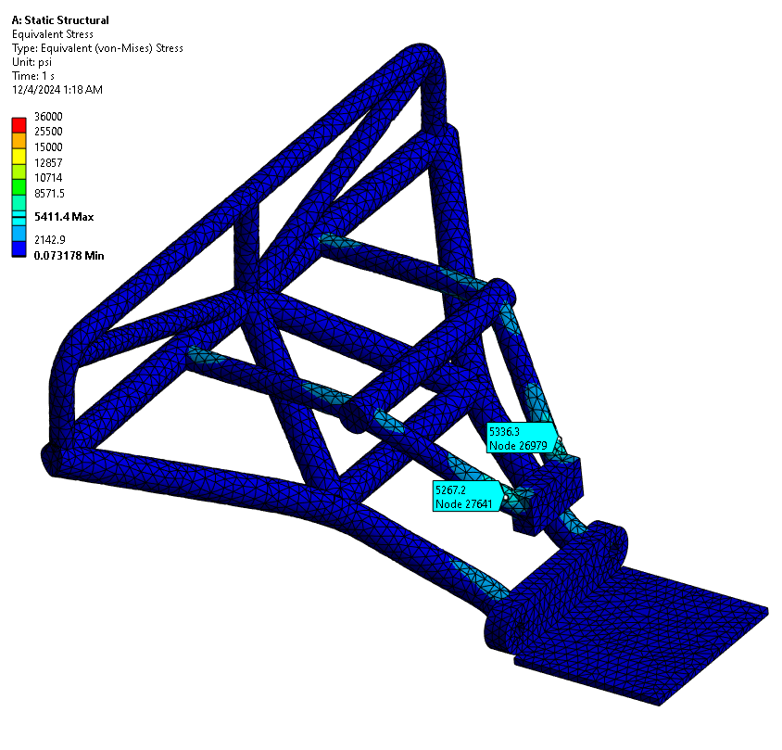
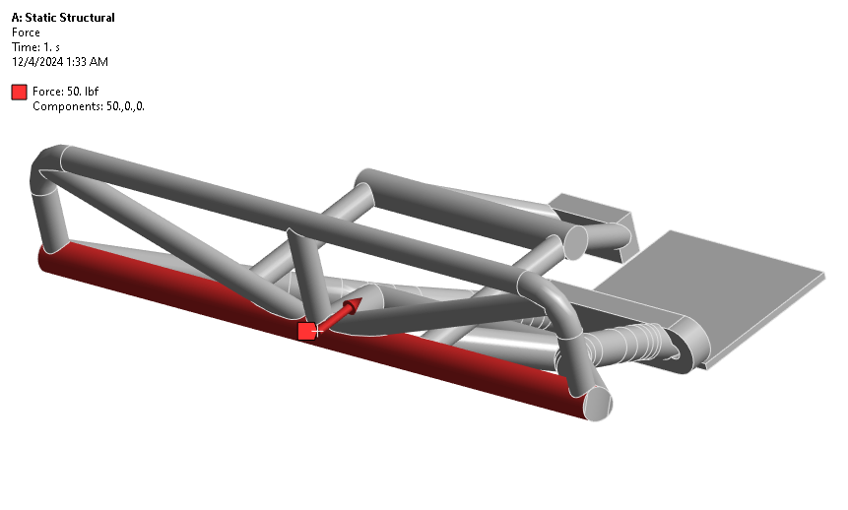
Analysis and Optimization
Rear Bumper FEA
Cylindrical Supports at bolt holes, all fixed
Tetrahedral Mesh size: .1”
Force applied: 50 lbf

Slide 31
CFD

Slide 32
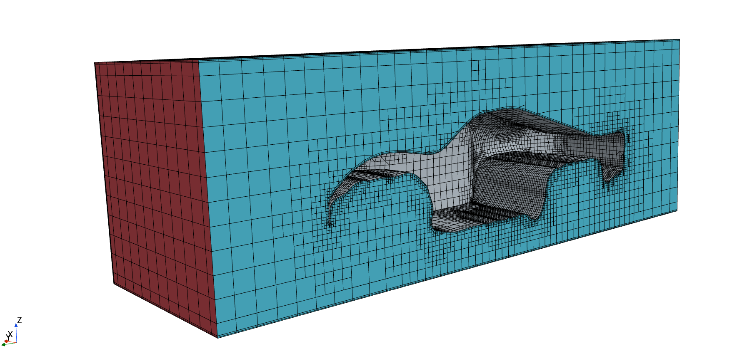
CFD
Shell CFD
Mock wind tunnel created in CAD
Meshers: Surface Remesher, Trimmed Cell Mesher, Prism Layer Mesher
Element Size: 0.025m
Prism Layer Total Thickness: 10% (of base size)
Physics Model Selection: Gas, Segregated Flow, Ideal Gas, Segregated Fluid Temperature, Steady, Turbulent, K-Epsilon Turbulence
Test Cases: 36 mph, 45 mph, 70 mph, 100 mph

Slide 33
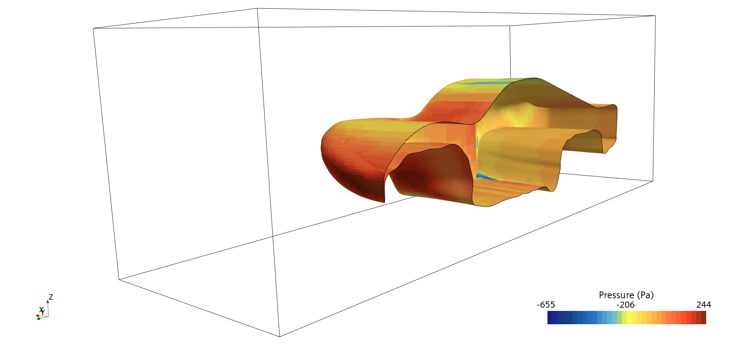
CFD
36 mph – Scalar Scene

Slide 34
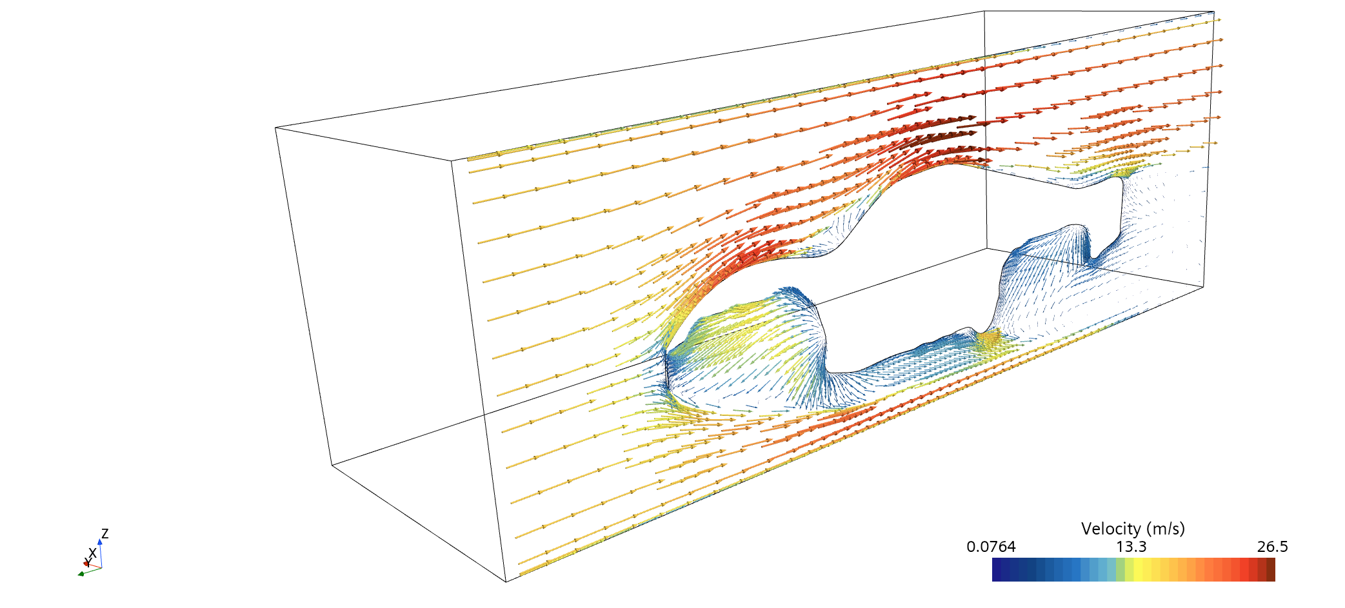
CFD
36 mph – Vector Scene

Slide 35
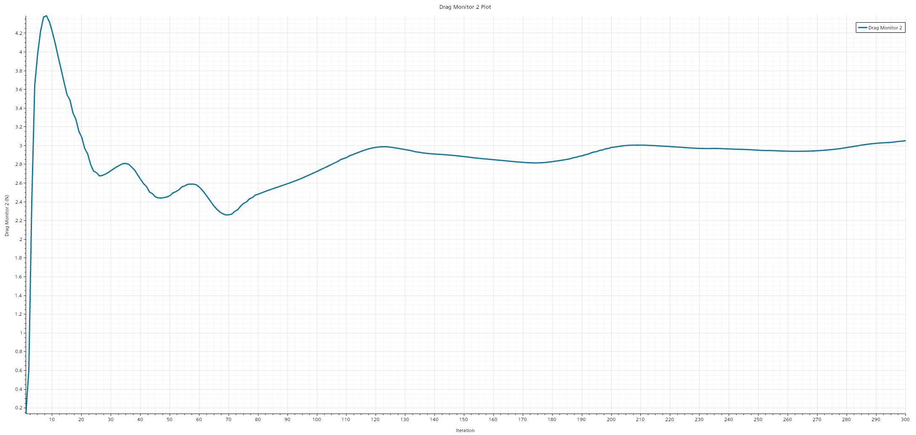
CFD
36 mph – Drag Force Plot

Slide 36
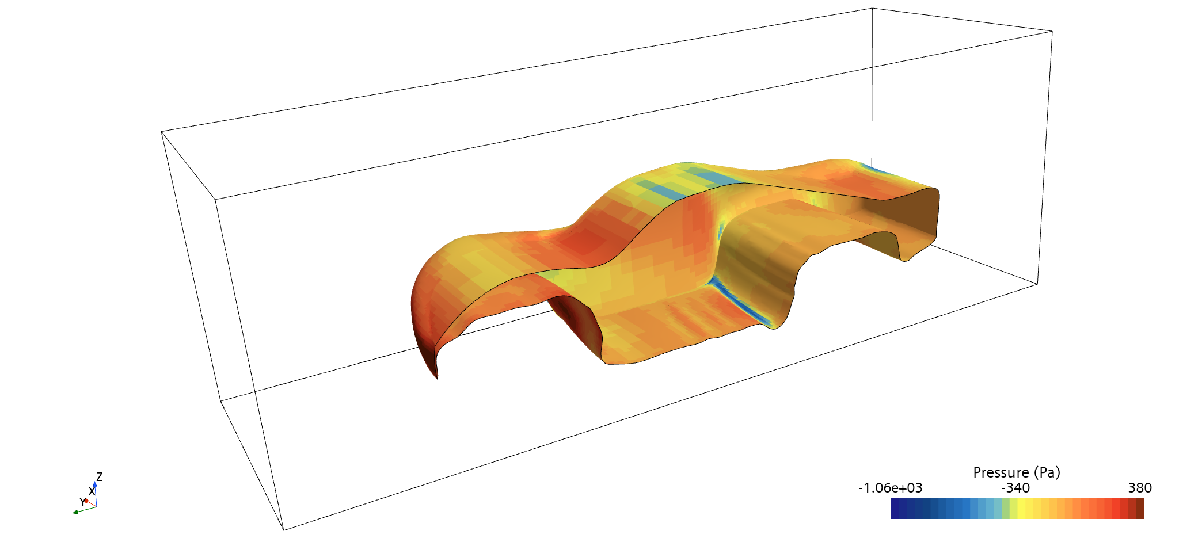
CFD
45 mph – Scalar Scene

Slide 37
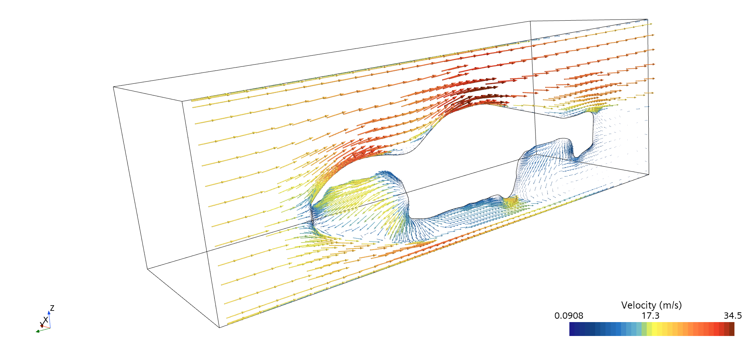
CFD
45 mph – Vector Scene

Slide 38
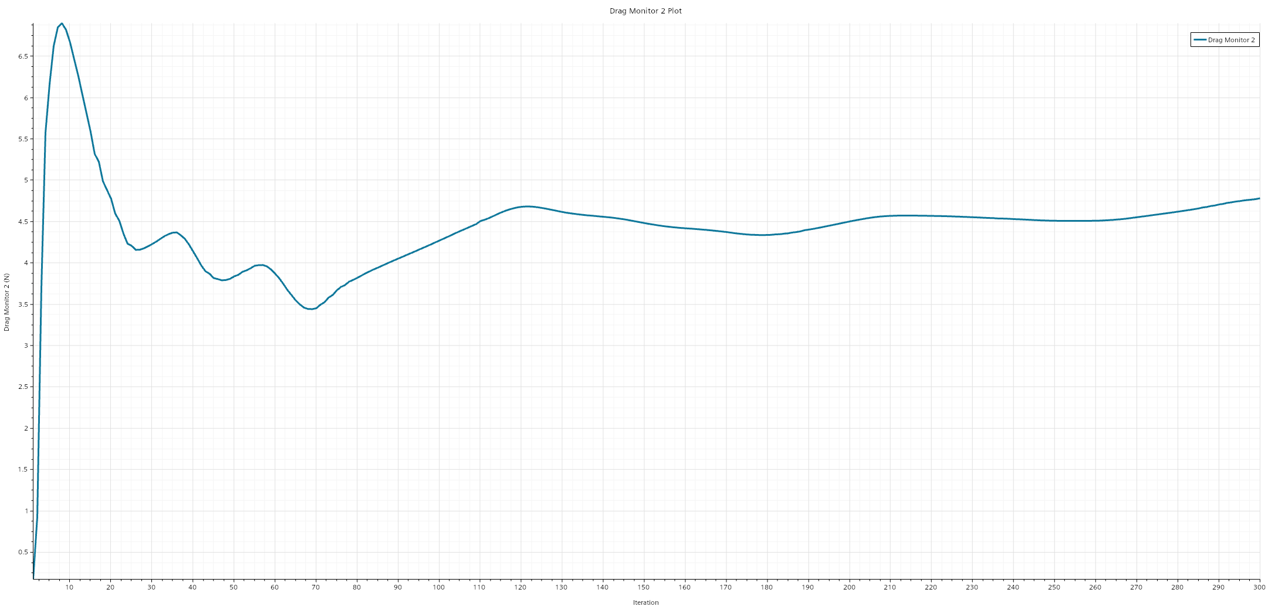
CFD
45 mph – Drag Force Plot

Slide 39
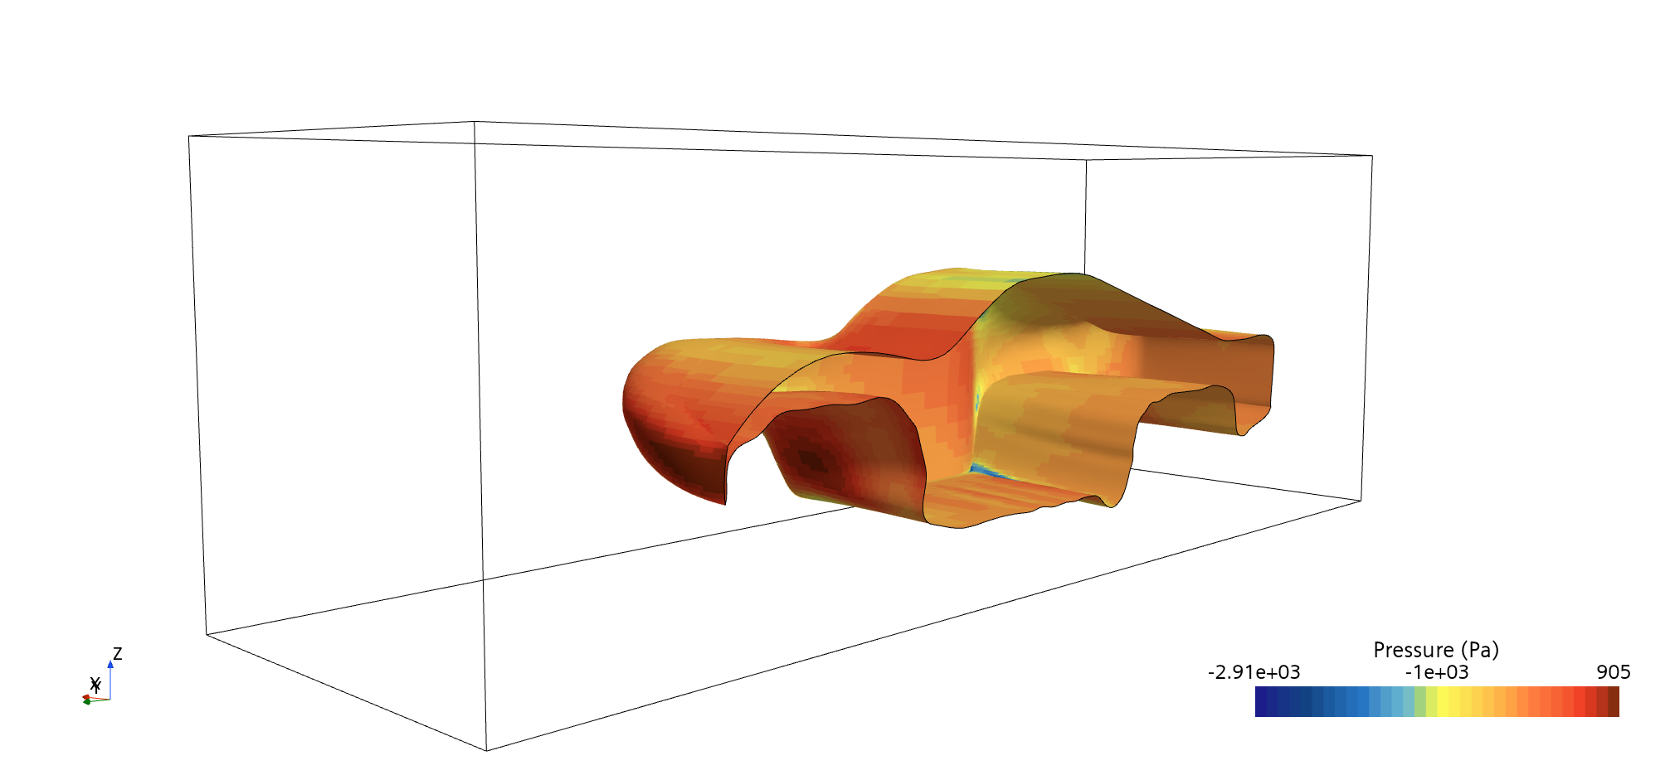
CFD
70 mph – Scalar Scene

Slide 40
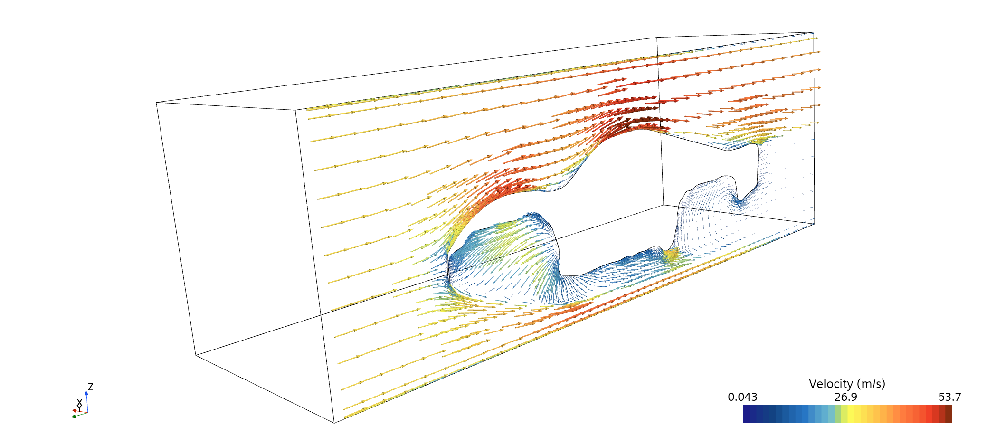
CFD
70 mph – Vector Scene

Slide 41

CFD
70 mph – Drag Force Plot

Slide 42

CFD
100 mph – Scalar Scene

Slide 43

CFD
100 mph – Vector Scene

Slide 44

CFD
100 mph – Drag Force Plot

Slide 45
CFD
Drag Force at 300th Iteration
Drag Increases as speed goes up in expected manner
Therefore, methodology conducted for CFD is valid and these results can be used to draw some conclusions
Case | Force (N)
36 mph | 3 N
45 mph | 4.75 N
70 mph | 10.8 N
100 mph | 22 N

Slide 46
Visualization

Slide 47

Visualization
Full Assembly Visualization

Slide 48

Visualization
Full Assembly Visualization

Slide 49

Visualization
Full Assembly Visualization

Slide 50

Visualization
Full Assembly Visualization

Slide 51

Part Visualization
Suspension Assembly Visualization

Slide 52

Part Visualization
Shell Visualization

Slide 53
Improvements, Successes, and Difficulties
What we did well:
Thorough FEA, CFD, and Topology Optimization
Unaltered CAD for optimization later
Communication
Organization
Future Improvements:
Focused on optimizing wide range of parts, did not have time to implement them into CAD
Phase out OneDrive (not good for CAD structures and file sharing) for Teamcenter, etc.
More robust scaling factor
More CFD at different angles
Rear wing addition, other technical improvements
Difficulties
Version control for CAD parts and assemblies
Breaking or replacing references when files moved for organizational purposes or scaled
File sharing system made development slower
Scaling factor, when changed, would randomly break some constraints in assemblies
Difficult time constraints prevented implementation of optimized parts into assembly for accurate weights

Slide 54
Thank You

